Slide 1


Introduction to Machine Learning
DBDA.X408.(33)
Instructor:
Bill Chen
UCSC Silicon Valley Extension
E: xchen375@ucsc.edu

Slide 2
Question, Quizzes, Assignments, Final Project
Python coding session for data mining, machine learning algorithms.
Office hour → Comment on the announcement
Sign-on sheet for final project will be in assignment.
Stopped at PCA, need to explain again next time.
Modify the quiz since we didn’t finish.
Quiz answers need to post.
Check the video upload.

Slide 3
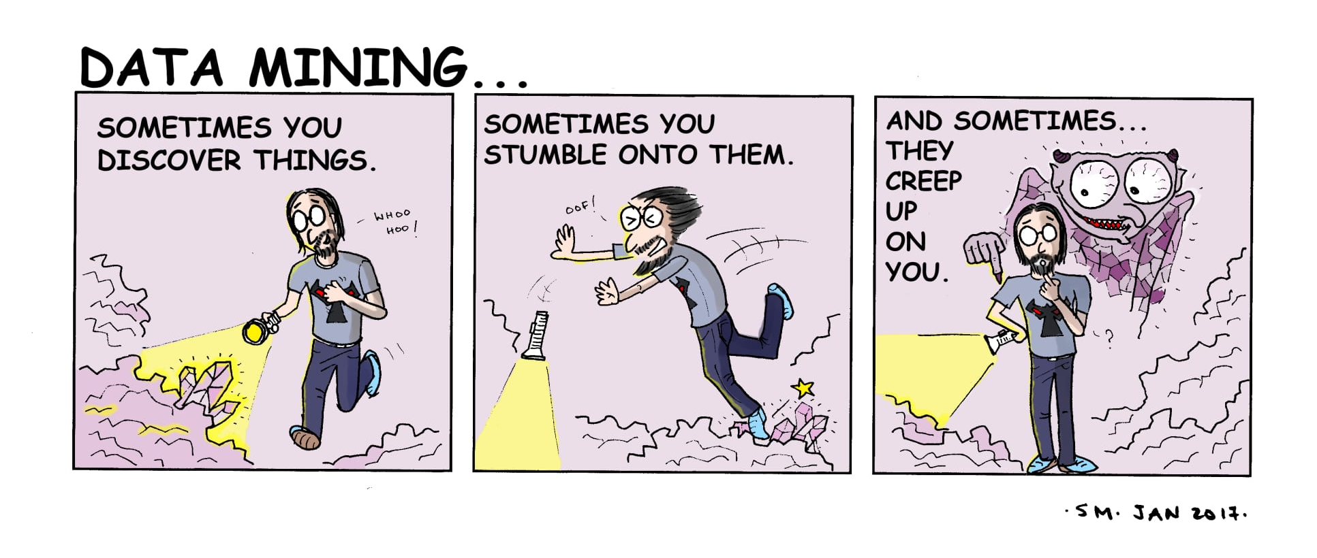
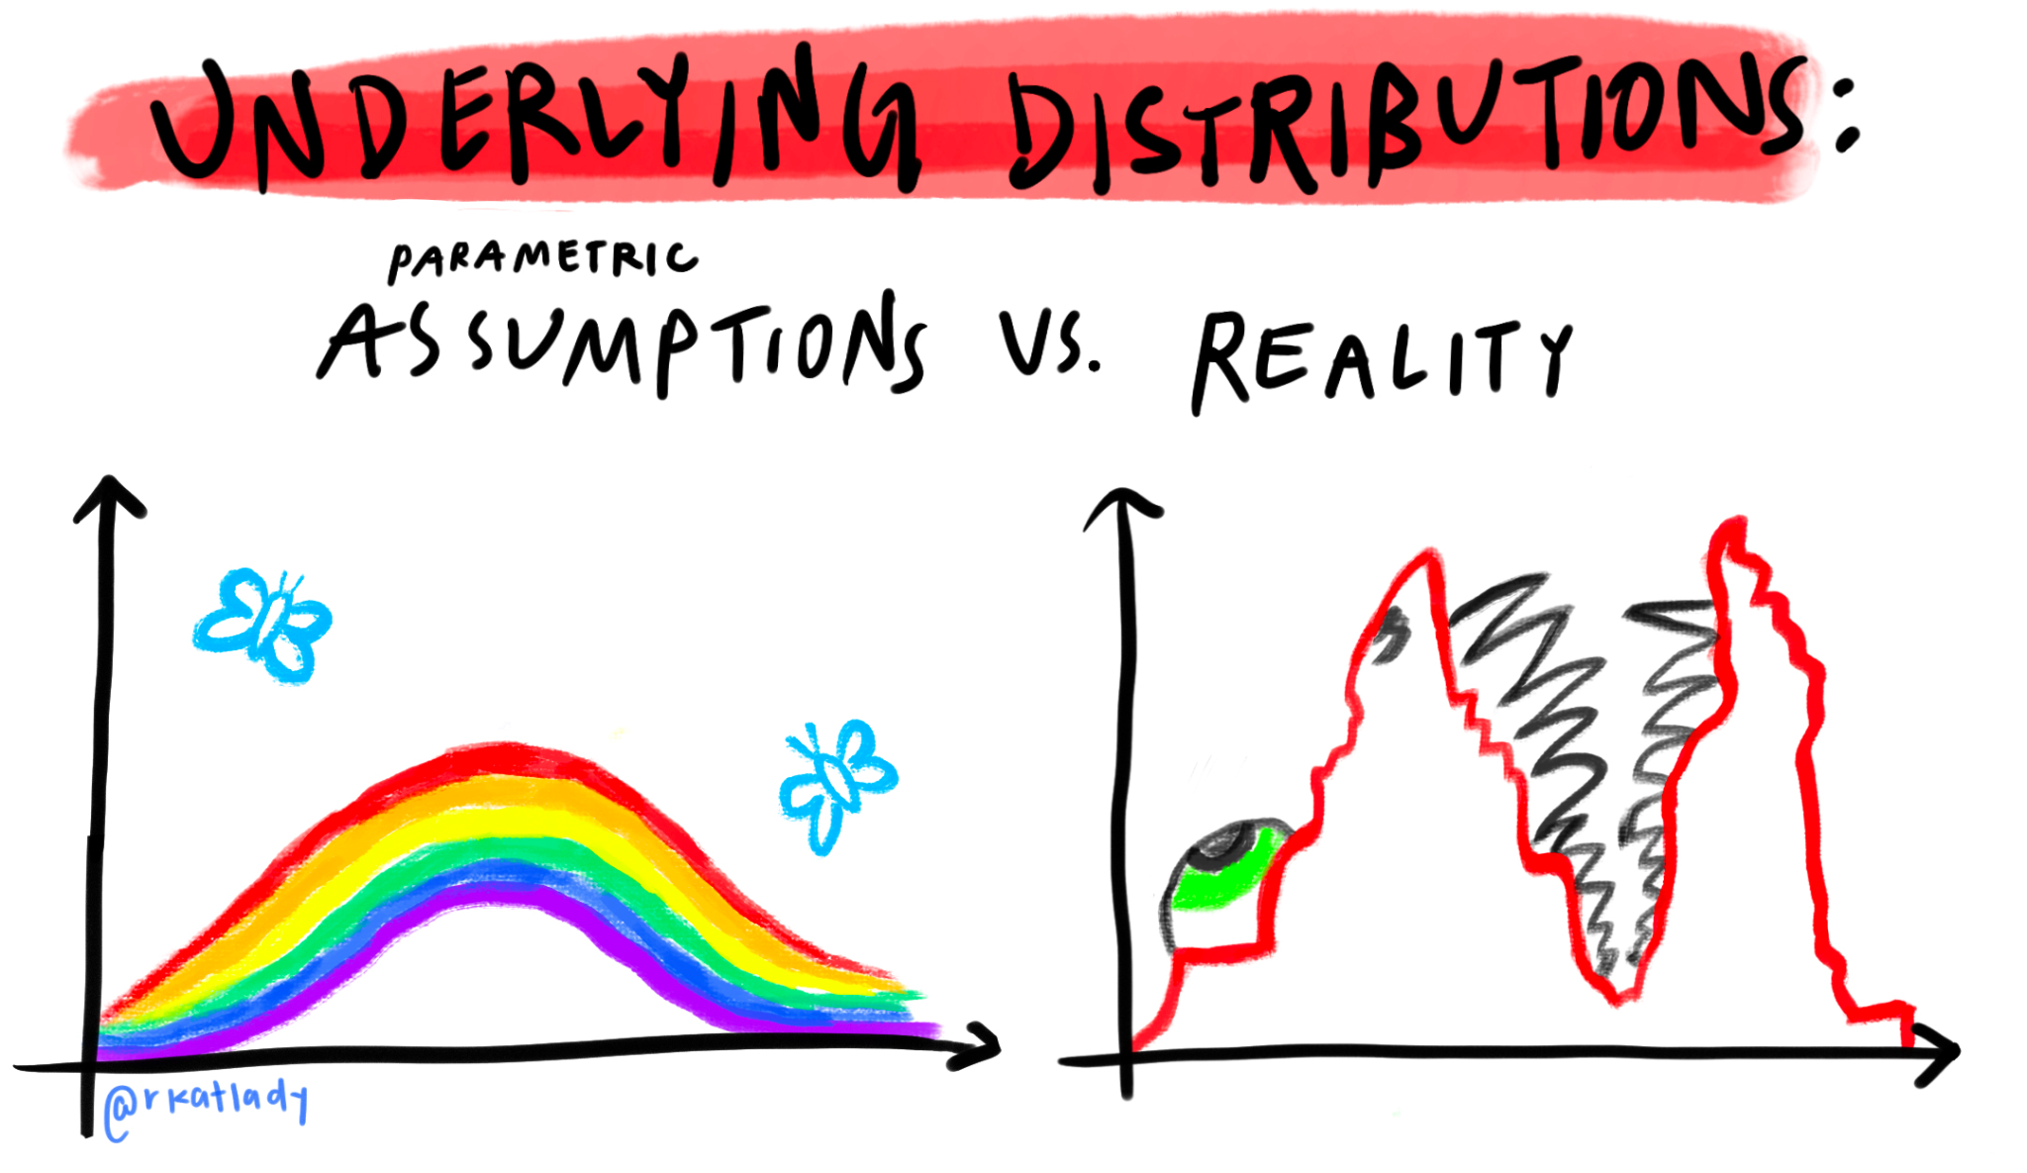
Week 3
Data Mining
Dimension Reduction
Principal Component Analysis
Input Data Processing
Unsupervised classification
GMM
Expectation-Maximization
K-Means

Slide 4



Data contains value and knowledge
And they could be dangerous

Slide 5
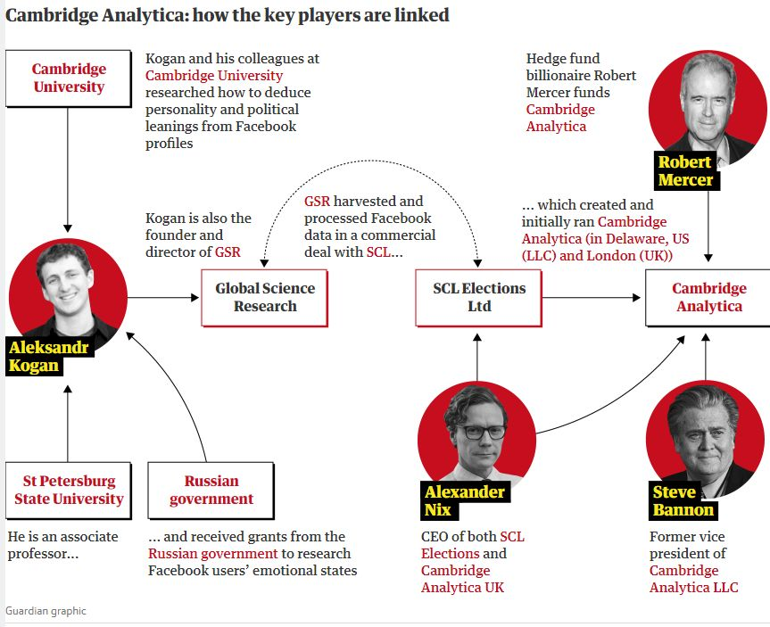

What kind of algorithm used?
https://theconversation.com/how-cambridge-analyticas-facebook-targeting-model-really-worked-according-to-the-person-who-built-it-94078

Slide 6
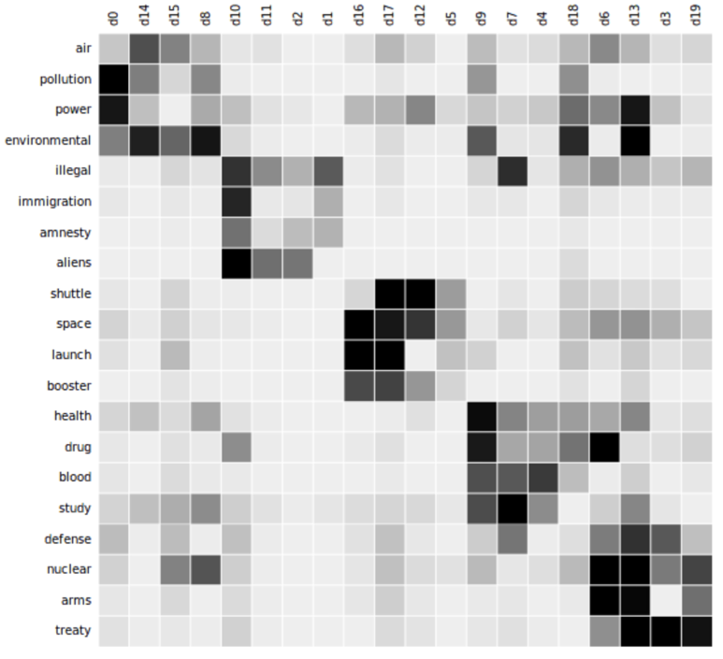
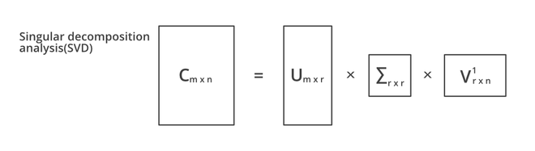
Latent Semantic Analysis (LSA)
From Week 1
C is the original word x document matrix with m words and n docs.
U describes the original row entities as vectors of derived orthogonal factor values
V describes the original column entities in the same way
Σ is a diagonal matrix containing scaling values
https://upload.wikimedia.org/wikipedia/commons/6/6e/Topic_detection_in_a_document-word_matrix.gif?20170329150506

Slide 7
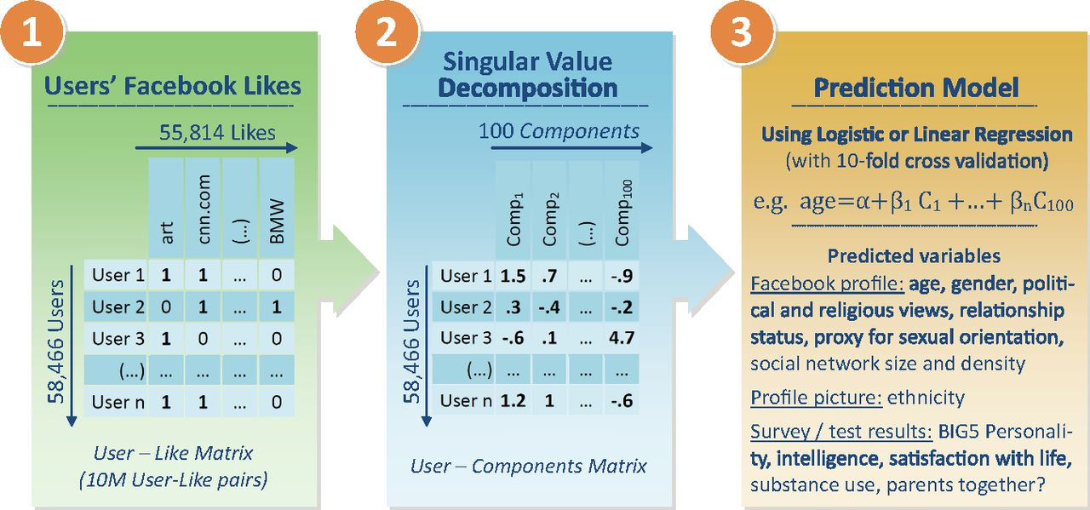
SVD-like Model
“We didn’t exactly use SVD,” he wrote, noting that SVD can struggle when some users have many more “likes” than others. Instead, Kogan explained, “The technique was something we actually developed ourselves … It’s not something that is in the public domain.” Without going into details, Kogan described their method as “a multi-step co-occurrence approach.”
However, his message went on to confirm that his approach was indeed similar to SVD or other matrix factorization methods, like in the Netflix Prize competition, and the Kosinki-Stillwell-Graepel Facebook model. Dimensionality reduction of Facebook data was the core of his model.
https://www.pnas.org/doi/10.1073/pnas.1218772110

Slide 8
Data Mining
To get knowledge from the data:
Storage
Management
Analysis (we are focus on this week)
Data mining = extraction of actionable information from (usually) very large datasets, is the subject of extreme hype, fear, and interest.
Focus on the algorithms that scale: parallelization
Data Mining ≈ Big Data ≈ Predictive Analytics ≈ Data Science ≈ Machine Learning

Slide 9
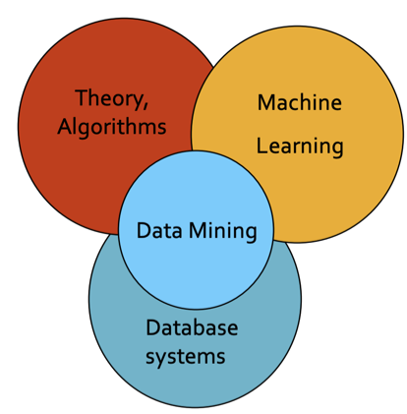
Data Mining Methods
Descriptive methods:
Find human-interpretable patterns that describe the data
Example: Clustering
Predictive methods:
Use some variables to predict unknown or future values of other variables
Example: Recommender systems

Slide 10
The Topics Could Be
Different types of data:
Data is high dimensional
Data is a graph
Data is infinite/never-ending
Data is labeled
Different Models of Computation:
MapReduce
Streams and online algorithms
Single machine in-memory
Real-world Problems:
Recommender systems
Market Basket Analysis
Spam detection
Duplicate document detection
Various “Tools”:
Linear algebra (SVD, Rec. Sys., Communities)
Optimization (stochastic gradient descent)
Dynamic programming (frequent itemsets)
Hashing (LSH, Bloom filters)

Slide 11
Distributed Computing for Data Mining

Slide 12
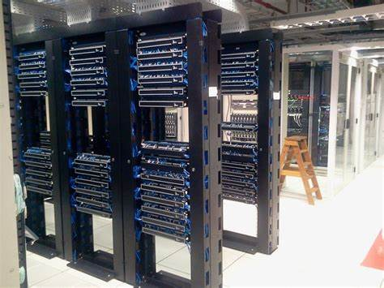
Large-scale Computing

Slide 13
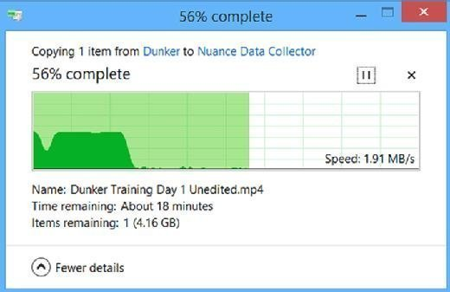
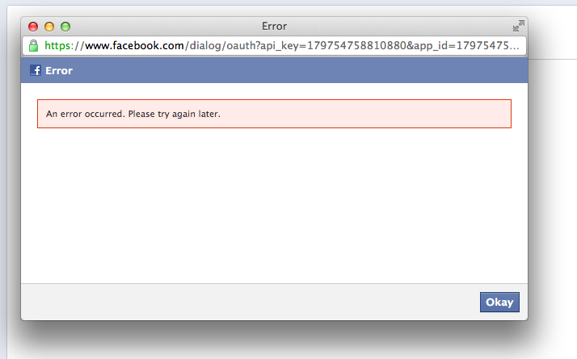
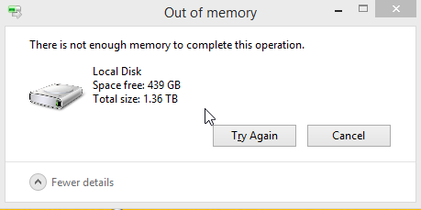
Challenges:
Copying data over a network takes time.
Machines can fail.
One server may stay up 3 years (1,000 days)
If you have 1,000 servers, expect to lose 1/day
With 1M machines 1,000 machines fail every day!
Storage is limited.

Slide 14
Challenges:
Spark/Hadoop
Copying data over a network takes time.
Machines can fail.
One server may stay up 3 years (1,000 days)
If you have 1,000 servers, expect to lose 1/day
With 1M machines 1,000 machines fail every day!
Storage is limited.
Bring computation to data
Store files multiple times for reliability
Storage Infrastructure – File system
Google: GFS.
Hadoop: HDFS
Programming model:
MapReduce
Spark

Slide 15
Challenges:
Distributed File System
Copying data over a network takes time.
Machines can fail.
One server may stay up 3 years (1,000 days)
If you have 1,000 servers, expect to lose 1/day
With 1M machines 1,000 machines fail every day!
Storage is limited.
Provides global file namespace
Typical usage pattern:
Huge files (100s of GB to TB)
Data is rarely updated in place
Reads and appends are common
If nodes fail, how to store data persistently?

Slide 16
Challenges:
Distributed File System
Copying data over a network takes time.
Machines can fail.
One server may stay up 3 years (1,000 days)
If you have 1,000 servers, expect to lose 1/day
With 1M machines 1,000 machines fail every day!
Storage is limited.
Chunk servers
File is split into contiguous chunks
Typically each chunk is 16-64MB
Each chunk replicated (usually 2x or 3x)
Try to keep replicas in different racks
Master node
a.k.a. Name Node in Hadoop’s HDFS
Stores metadata about where files are stored
Master nodes are typically more robust to hardware failure and run critical cluster services.
Client library for file access
Talks to master to find chunk servers
Connects directly to chunk servers to access data
If nodes fail, how to store data persistently?

Slide 17
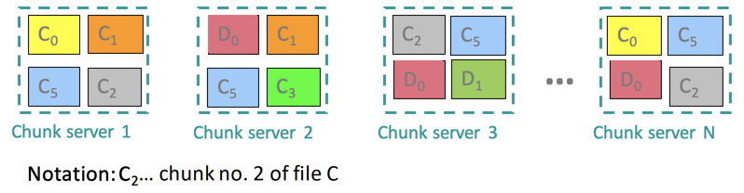
Challenges:
Distributed File System
Copying data over a network takes time.
Machines can fail.
One server may stay up 3 years (1,000 days)
If you have 1,000 servers, expect to lose 1/day
With 1M machines 1,000 machines fail every day!
Storage is limited.
Reliable distributed file system
Data kept in “chunks” spread across machines
Each chunk replicated on different machines
Seamless recovery from disk or machine failure
Notes:
Bring computation directly to the data!
Chunk servers also serve as compute servers.

Slide 18
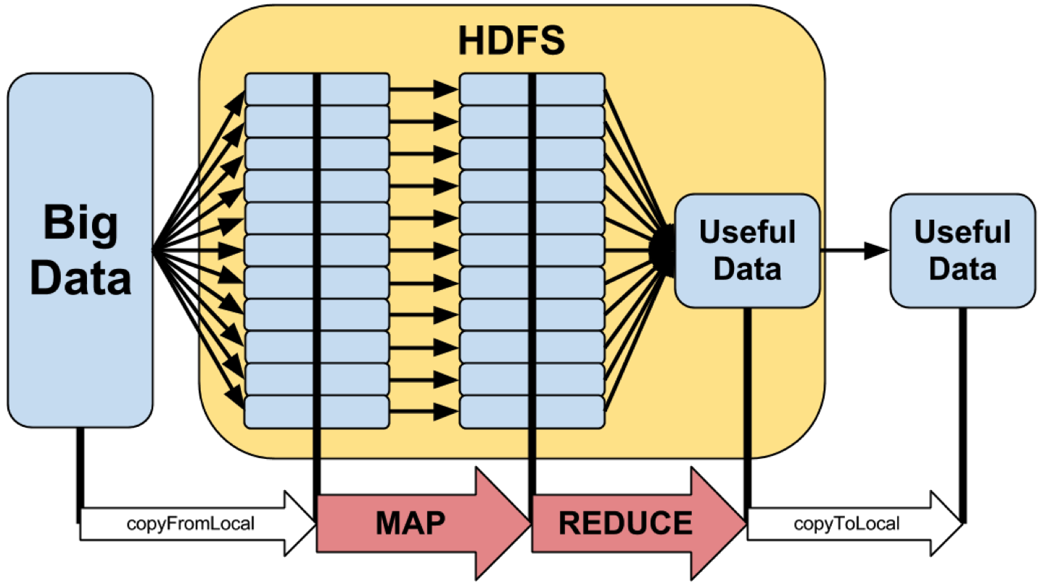
MapReduce
MapReduce is a style of programming designed for:
Easy parallel programming
Invisible management of hardware and software failures
Easy management of very-large-scale data
It has several implementations, including Hadoop, Spark (used in this class), Flink, and the original Google implementation just called “MapReduce”

Slide 19
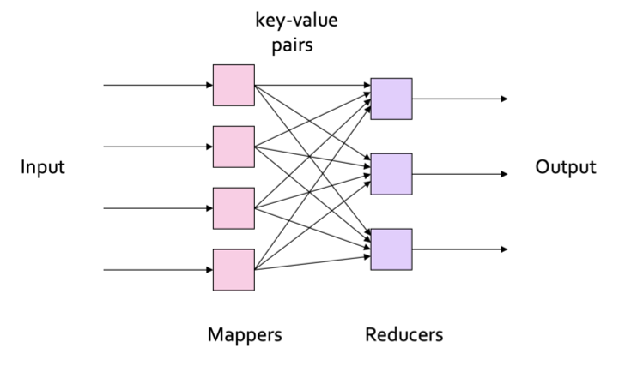
MapReduce
3 steps of MapReduce:
Map:
Apply a user-written Map function to each input element
Mapper applies the Map function to a single element
Many mappers grouped in a Map task (the unit of parallelism)
The output of the Map function is a set of 0, 1, or more key-value pairs.
Group by key: Sort and shuffle
System sorts all the key-value pairs by key, and outputs key-(list of values) pairs
Reduce:
User-written Reduce function is applied to each key-(list of values)

Slide 20
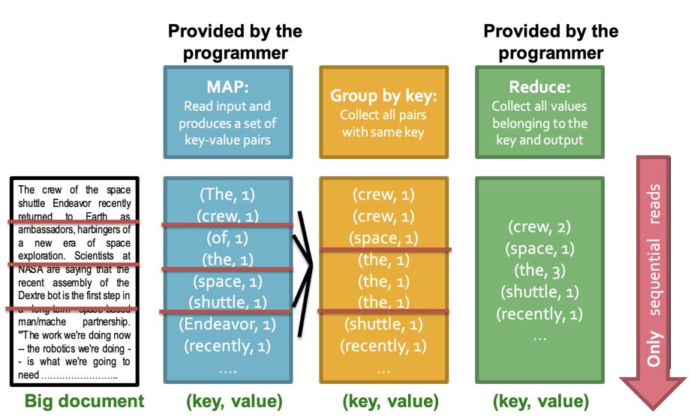
Example: Word Counting
Example MapReduce task:
We have a huge text document
Count the number of times each distinct word appears in the file
Many applications of this:
Analyze web server logs to find popular URLs
Statistical machine translation:
Need to count number of times every 5-word sequence occurs in a large corpus of documents

Slide 21
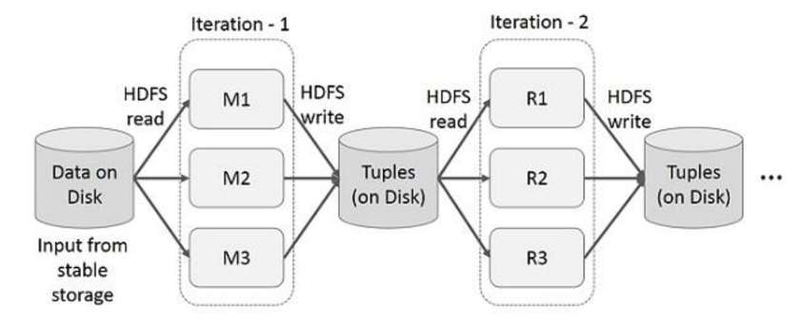
Spark: Extends MapReduce
Problem with MapReduce: Incurs substantial overheads due to data replication, disk I/O, and serialization
Two major limitations of MapReduce:
Difficulty of programming directly in MapReduce
Many problems aren’t easily described as map-reduce
Performance bottlenecks, or batch not fitting the use cases
Persistence to disk typically slower than in-memory work
In short, MapReduce doesn’t compose well for large applications
Many times, one needs to chain multiple mapreduce steps.

Slide 22
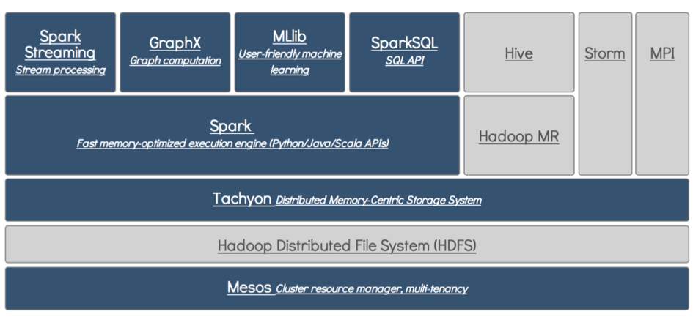
Data Analytics Software Stack

Slide 23
Spark: Most Popular Data-Flow System
Expressive computing system, not limited to the mapreduce model
Addition to MapReduce model:
Fast data sharing
Avoids saving intermediate results to disk
Caches data for repetitive queries (e.g. for machine learning)
General execution graphs (DAGs)
Richer functions than just map and reduce
Compatible with Hadoop
Overview:
Open source software (Apache)
Support Java, Scala and Python
Key construct/idea: Resilient Distributed Dataset (RDD)
Higher-level APIs: DataFrames and DataSets
Introduced in more recent versions of Spark
Different APIs for aggregate data, which allowed to introduce SQL support.

Slide 24
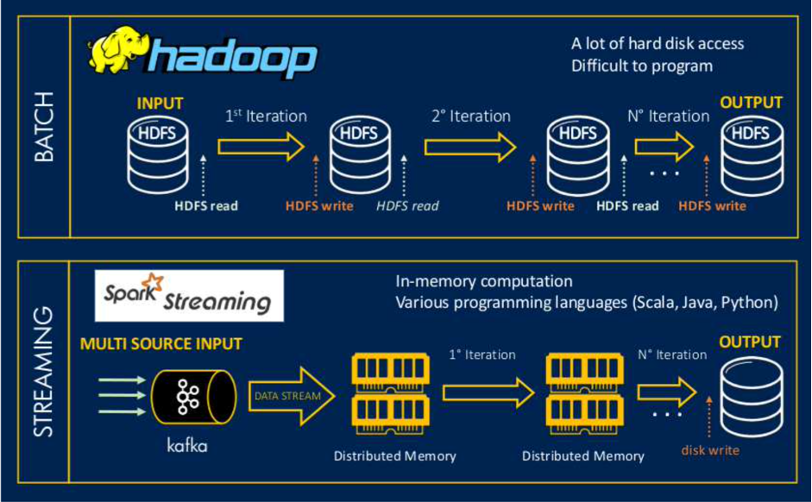
Hadoop vs. Spark

Slide 25
Input Data Processing

Slide 26
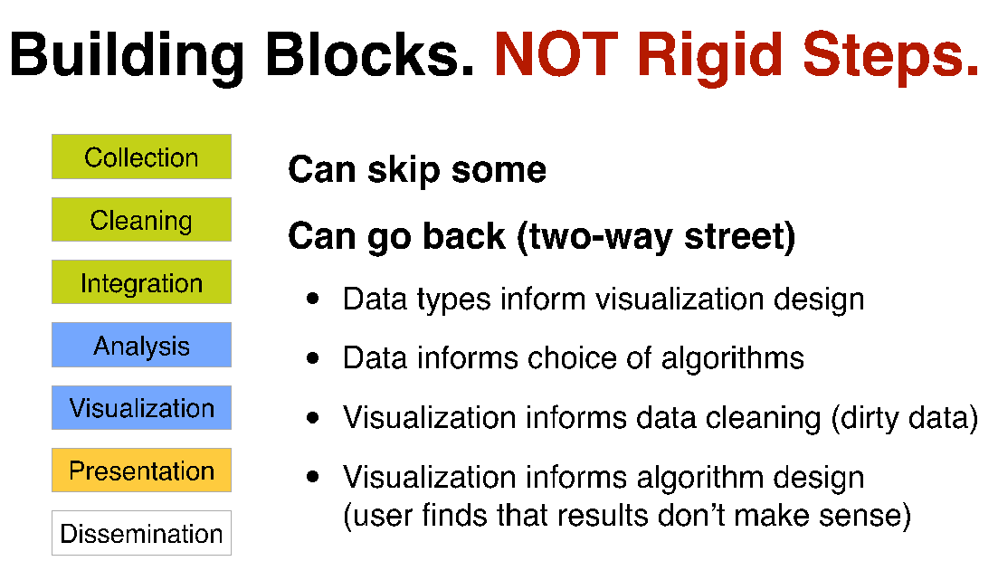


Slide 27
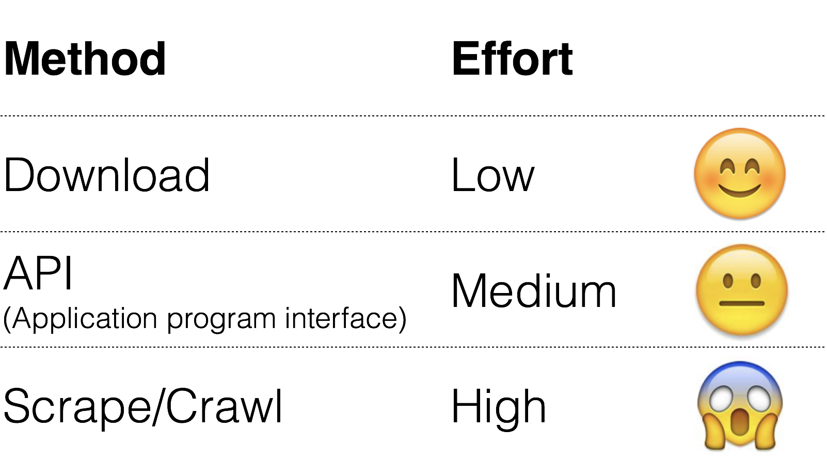
How to Collect Data?

Slide 28
Data You Can Just Download
NYC Taxi data: Trip (11GB), Fare (7.7GB)
StackOverflow (xml)
Wikipedia (data dump)
Atlanta crime data (csv)
Soccer statistics
…

Slide 29
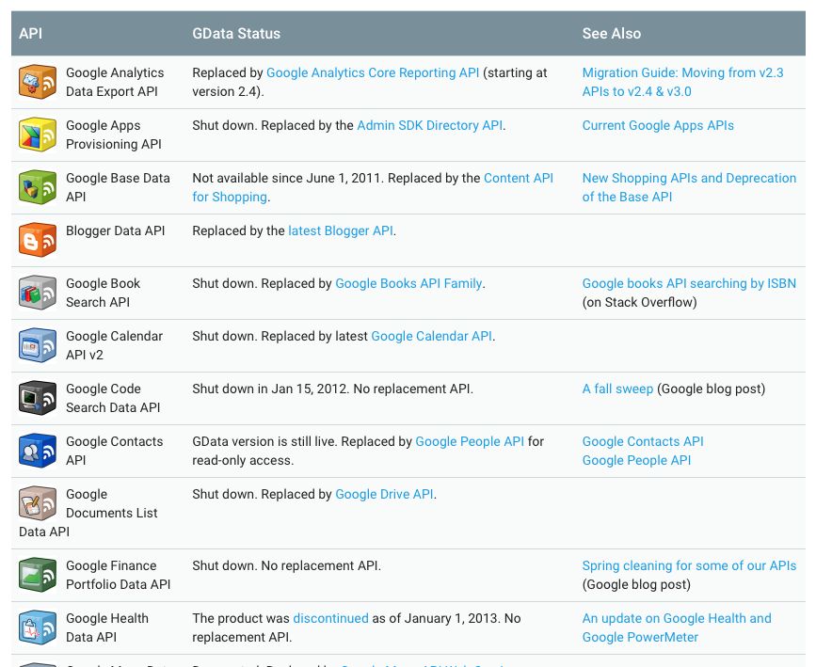
Collect Data via APIs
Google Data API (e.g., Google Maps Directions API) https://developers.google.com/gdata/docs/directory
Twitter (small subset) https://dev.twitter.com/streaming/overview
Last.fm (Pandora has unofficial API)
Flickr
data.nasa.gov
data.gov
Facebook (your friends only)
https://developers.google.com/gdata/docs/directory
Notes:
Application programming interface

Slide 30
Data Unavailable via APIs
Amazon (reviews, product info)
ESPN
eBay
Google Play
Google Scholar
…

Slide 31
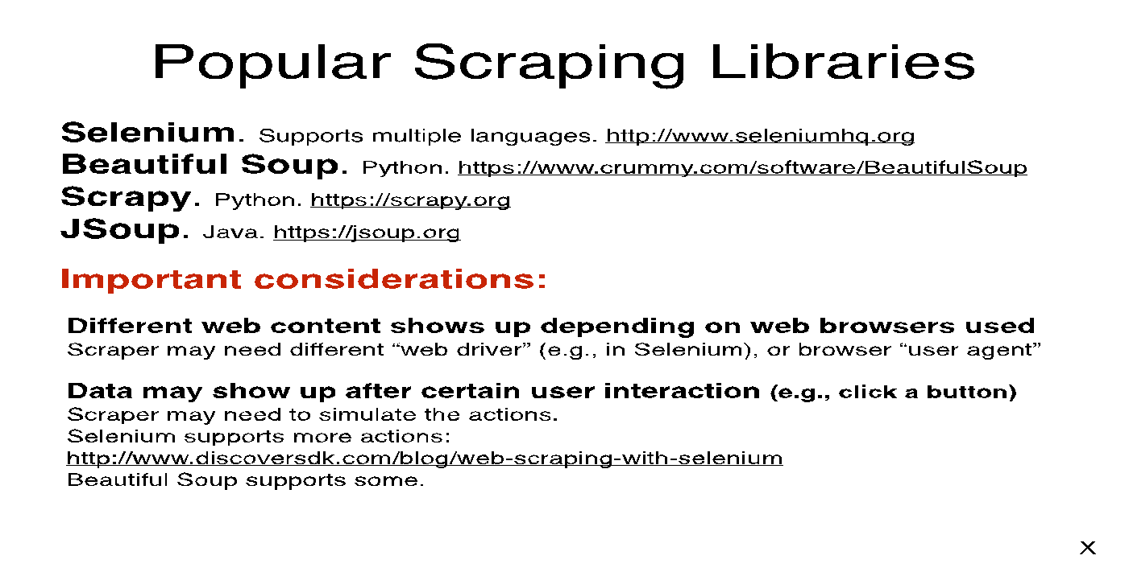
Popular Scraping Libraries
Notes:
URL sizes decreased to 14 to accommodate entire content in a single slide.

Slide 32
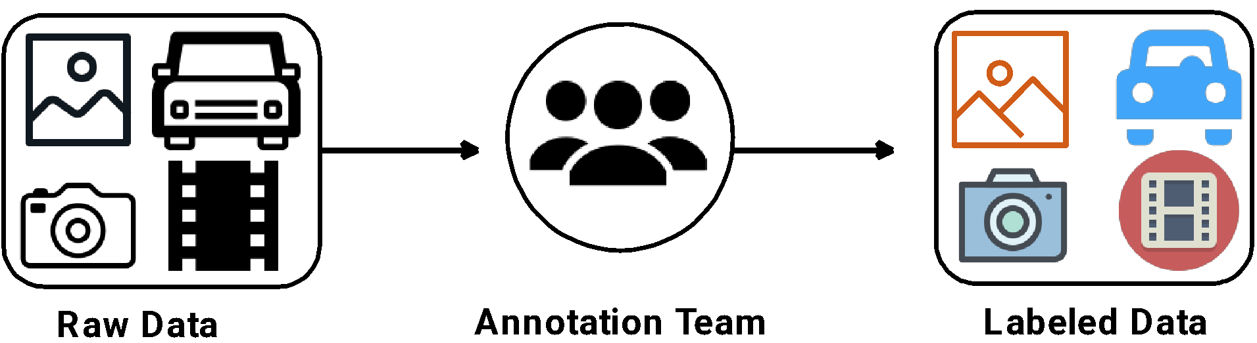
Data Annotation
Data annotation is the labelling of collected data for various applications.
Image Processing
Natural Language Processing
Smart Grid
…
Notes:
Data annotation is necessary to build machine learning models, especially for supervised learning models in different applications such as Image Processing, Natural Language Processing, and Smart Grids.
This figure shows general flow of data annotation.
The first step is to collect raw data from different sources.
Then we have to construct a team with different expertise, especially domain experts for the applications.
Prior to data annotation the team has to work together to complete annotation guidelines.
Finally, with these guidelines, the team will complete data annotations on the raw data and evaluate the annotation results.

Slide 33
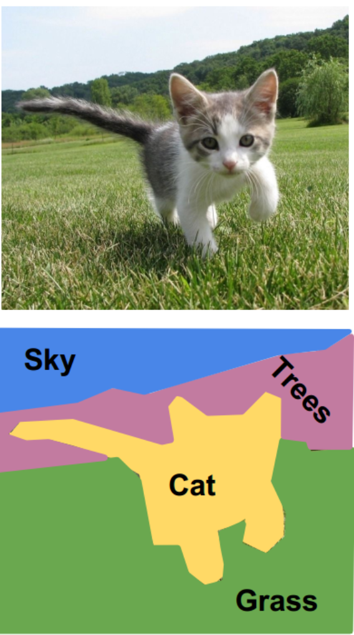
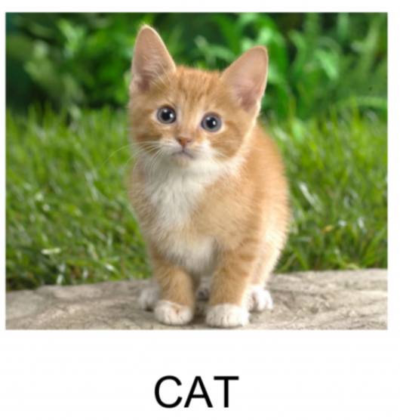
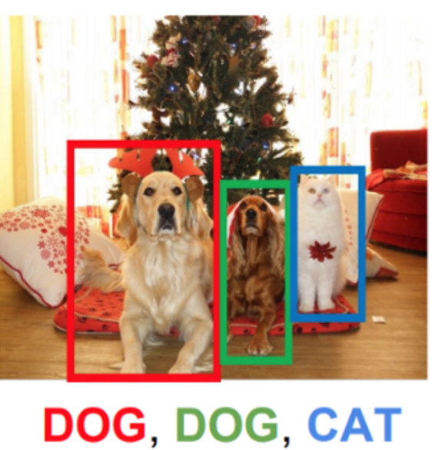
Image Processing
Examples of data annotation
Semantic Segmentation
Image Classification
Object Detection
Notes:
First example of data annotation is about image processing.
These three figures present the annotation for image classification, object detection, and semantic segmentation.

Slide 34
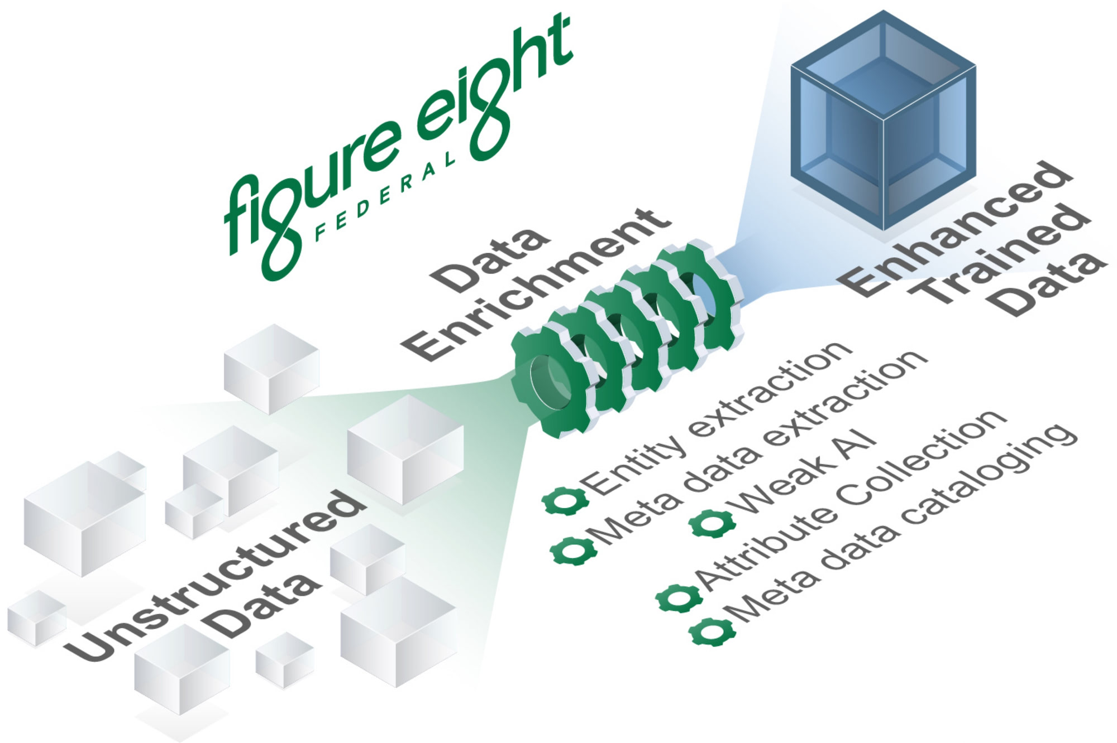
Figure 8 – Paid Company from SF
https://f8federal.com/ from Apple.
Notes:
Features
Image annotation for polygon, rectangle, circle, line and point.
Image flag annotation for classification and cleaning.
Video annotation. (video annotation)
GUI customization (predefined labels / flags, auto-saving, label validation, etc).
Exporting VOC-format dataset for semantic/instance segmentation. (semantic segmentation, instance segmentation)
Exporting COCO-format dataset for instance segmentation. (instance segmentation)

Slide 35
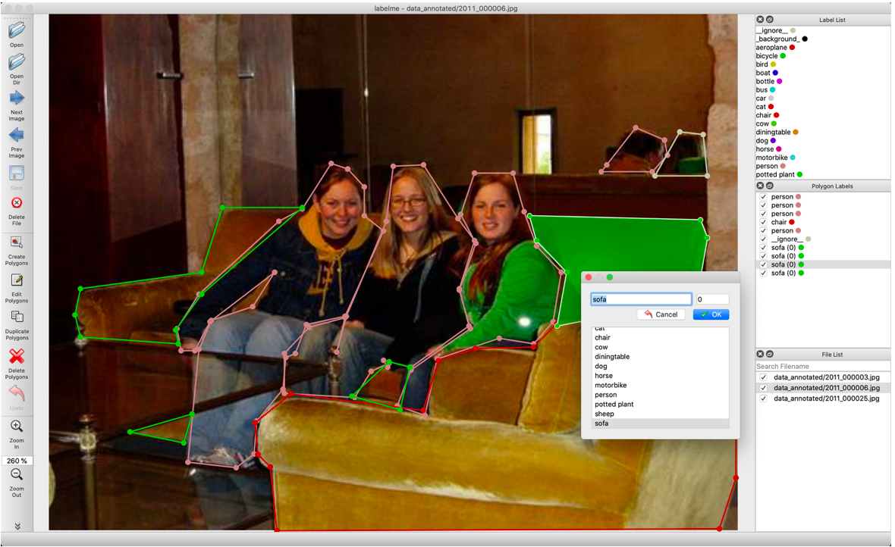
LabelMe
A graphical image annotation tool inspired by http://labelme.csail.mit.edu.
It is written in Python and uses Qt for its graphical interface.
Notes:
Features
Image annotation for polygon, rectangle, circle, line and point.
Image flag annotation for classification and cleaning.
Video annotation. (video annotation)
GUI customization (predefined labels / flags, auto-saving, label validation, etc).
Exporting VOC-format dataset for semantic/instance segmentation. (semantic segmentation, instance segmentation)
Exporting COCO-format dataset for instance segmentation. (instance segmentation)

Slide 36
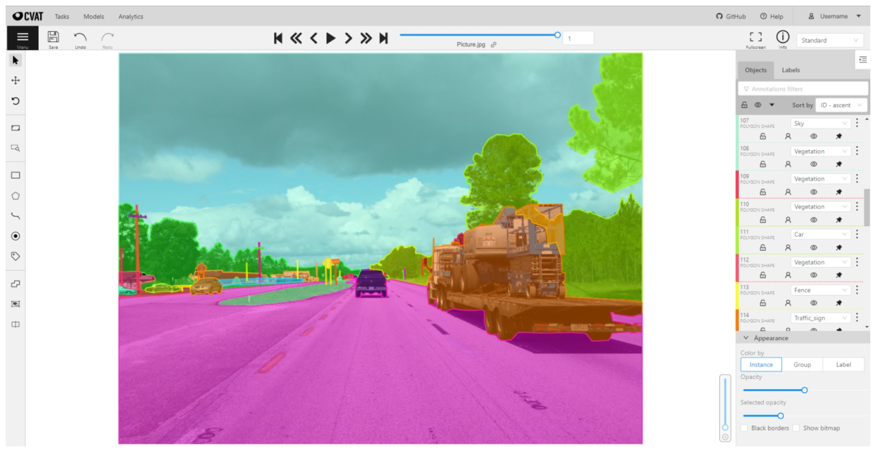
Computer Vision Annotation Tool (CVAT)
Open source
Auto annotation using trained DL models
Collaborative
Easy to deploy and maintain

Slide 37

Einstein Vision Object Detection
Open Source
Image Size Change and Move
Label Change and Remove
Easy to Use
Source: https://github.com/misu007/einstein-vision-object-detection-annotation-tool-sample

Slide 38
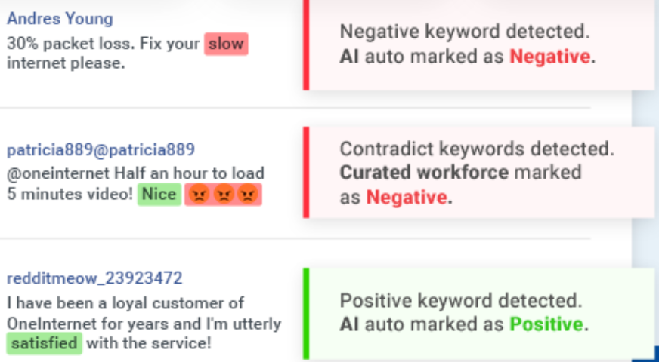

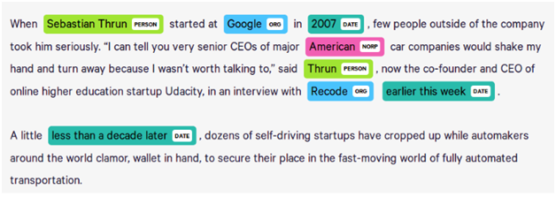
Natural Language Processing (NLP)
Sentiment Classification on Texts
Named Entity Recognition
Notes:
NLP is another application that requires substantial annotated data to build different applications.
Here are two examples of NLP tasks.
Sentiment analysis is a natural language processing technique used to determine whether data is positive, negative or neutral. It is often performed on textual data to help businesses monitor brand and product sentiment in customer feedback, and understand customer needs.
NER IS is a subtask of information extraction that seeks to locate and classify named entities mentioned in unstructured text into pre-defined categories such as person names, organizations, locations, medical codes, time expressions, quantities, monetary values, percentages, etc.
These two tasks needs labeled data shown with these two figures, respectively.

Slide 39
Quality Control for Data Annotation
Calculating the accuracy of an annotator compared to ground-truth data.
Calculating the overall agreement and reliability of a dataset.
Measuring inter-annotator agreement on a per-task basis to generate a confidence score for each training data label.
Designing architectures that incorporate subject matter experts into the annotation workflow.
Breaking up a task into simpler subtasks to improve accuracy, efficiency and quality control.
Source: https://livebook.manning.com/book/human-in-the-loop-machine-learning/chapter-8/v-8/1
Notes:
After completing data annotation, we need to evaluate the annotation quality.
It contains the steps shown here.

Slide 40
Data Quality (DQ)
WHY WE CARE?
High-quality data can be a major business asset, a unique source of competitive advantage.
Poor data quality can lower customer satisfaction.
Poor data quality can lower employee job satisfaction too, leading to excessive turnover and the resulting loss of key process knowledge.
Poor data quality can also breed organizational mistrust and make it hard to mount efforts that lead to needed improvements.
Data quality refers to the state of qualitative or quantitative pieces of information.
Data is of high quality if it is “Fit for Use” in their intended operational, decision-making and other roles.
Quality Properties
Relevance – does data meet basic needs?
Accuracy – are key data elements correct?
Timeliness – is data current?
Comparability: Can several databases be combined into a data warehouse?
Completeness No missing records, no missing data elements
Source:https://www.researchgate.net/profile/William_Winkler/publication/220695391_Data_Quality_and_Record_Linkage/links/551be3a90cf20d5fbde21e93.pdf
Notes:
Relevance: several facets are important to the relevance of the data analysts’ use of data.
Does the data meet the basic needs for which they were collected, placed in a database, and used?
Can the data be used for additional purposes (e.g., a market analysis)? If the data cannot presently be used for such purposes, how much time and expense would be needed to add the additional features?
Is it possible to use a database for several different purposes? A secondary (or possibly primary) use of a database may be better for determining what subsets of customers are more likely to purchase certain products and what types of advertisements or e-mails may be more successful with different groups of customers.
Accuracy:
Which customers will buy certain products in a grocery store? Which customers bought products (1) this week, (2) 12 months ago, and (3) 24 months ago? Should certain products be eliminated or added based on sales trends? Which products are the most profitable?
How will people vote in a Congressional election? We might be interested in demographic variables on individual voters – for example, age, education level, and income level. Is it acceptable here if the value of the income variable is within 20% of its true value? How accurate must the level of education variable be?
How likely are individuals to die from a certain disease? Here the context might be a clinical trial in which we are testing the efficacy of a new drug. The data fields of interest might include the dosage level, the patient’s age, a measure of the patient’s general health, and the location of the patient’s residence. How accurate does the measurement of the dosage level need to be? What other factors need to be measured (such as other drug use or general health level) because they might mitigate the efficacy of the new drug? Are all data fields being measured with sufficient accuracy to build a model to reliably predict the efficacy of various dosage levels of the new drug?
Timeliness
How current does the information need to be to predict which subsets of customers are more likely to purchase certain products? How current do public opinion polls need to be to accurately predict election results? If data editing delays the publication/release of survey results to the public, how do the delays affect the use of the data in (1) general-circulation publications and (2) research studies of the resulting micro-data files?
Is it appropriate to combine several databases into a data warehouse to facilitate the data’s use in (1) exploratory analyses, (2) modeling, or (3) statistical estimation? Are data fields (e.g., Social Security Numbers) present within these databases that allow us to easily link individuals across the databases? How accurate are these identifying fields? If each of two distinct linkable databases has an income variable, then which income variable is better to use, or is there a way to incorporate both into a model?
Here, by completeness we mean that no records are missing and that no records have missing data elements. In the survey sampling literature, entire missing records are known as unit non-response and missing items are referred to as item non-response. Both unit non-response and item non-response can indicate lack of quality. In many databases such as financial databases, missing entire records can have disastrous consequences. In survey and administrative databases, missing records can have serious consequences if they are associated with large companies or with a large proportion of employees in one subsection of a company. When such problems arise, the processes that create the database must be examined to determine whether (1) certain individuals need additional training in use of the software, (2) the software is not sufficiently user-friendly and responsive, or (3) certain procedures for updating the database are insufficient or in error.

Slide 41
How Do You Obtain High-Quality Data?
Prevention: Keep Bad Data Out of the Database/List
Detection: Proactively Look for Bad Data Already Entered
Repair: Let the Bad Data Find You and Then Fix Things
Allocating Resources: How Much for Prevention, Detection, and Repair
Source: http://content.schweitzer-online.de/static/catalog_manager/live/media_files/representation/zd_std_orig__zd_schw_orig/001/813/790/9780387695020_content_pdf_1.pdf
Notes:
To obtain high-quality data, we need to:
Prevention: Ensure that all data entering the database/list are of high quality.
Detection: the data analyst need proactively to look for data quality problems and then correct the problems.
Repair: the worst approach is to wait for data quality problems to surface on their own.
Allocating Resources: the question arises as to how best to allocate the limited resources available for a sample survey and an analytical study.
The typical mix of resources devoted to these three activities in the United States tends to be on the order of: Prevent: 10% Detect: 30% Repair: 60%.
Strongly suggests that a more cost-effective strategy is to devote a larger proportion of the available resources to preventing bad data from getting into the system and less to detecting and repairing (i.e., correcting) erroneous data. It is usually less expensive to find and correct errors early in the process than it is in the later stages. So, in our judgment, a much better mix of resources would be Prevent: 45% Detect: 30% Repair: 25%.

Slide 42
Data Storage
How to store the data?
What’s the easiest way?

Slide 43
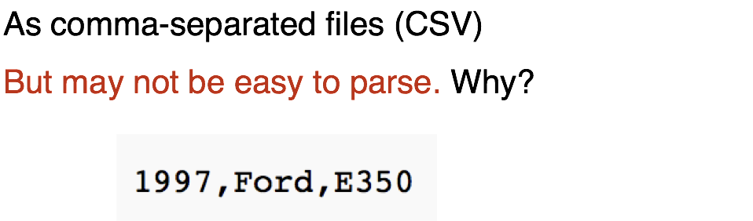
Easiest Way to Store Data

Slide 44
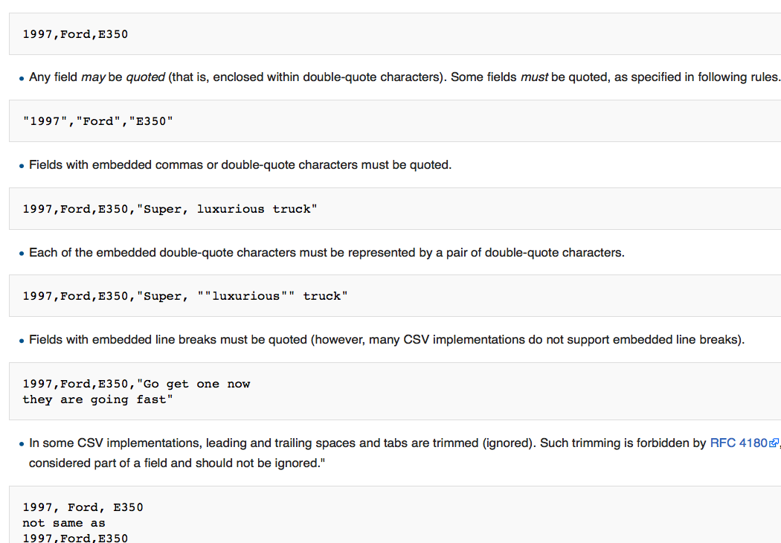
Easiest Way to Store Data
Retrieved: https://en.wikipedia.org/wiki/Comma-separated_values

Slide 45
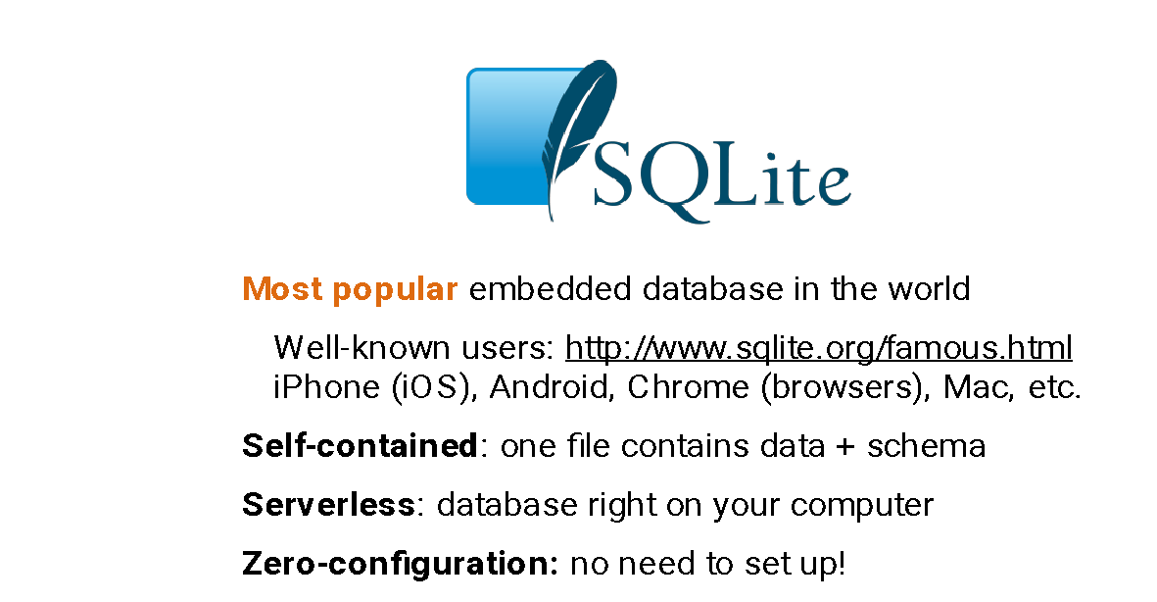
Retrieved: www.sqlite.org

Slide 46
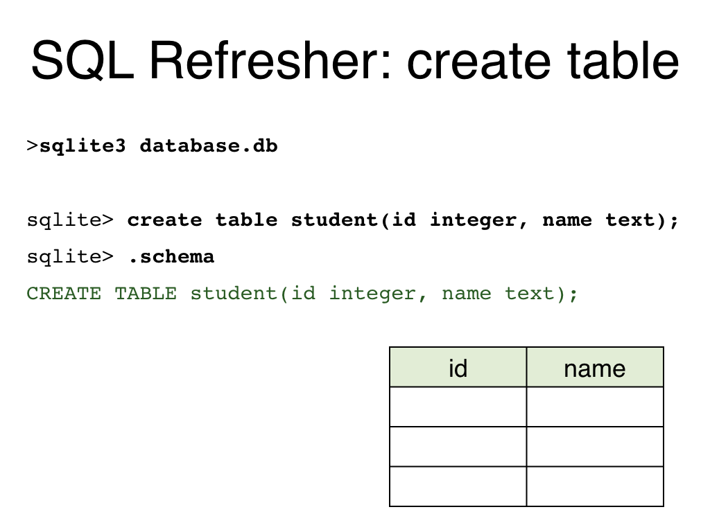

Slide 47
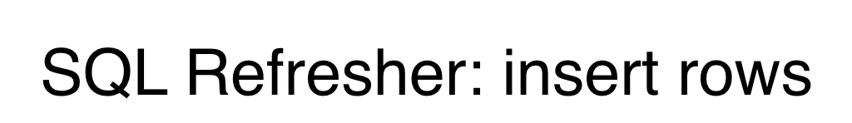
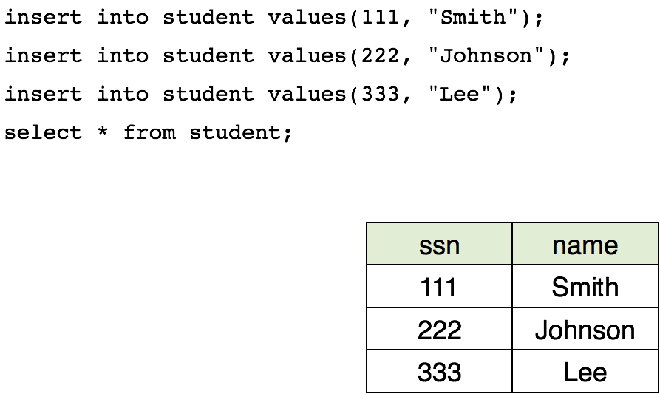

Slide 48
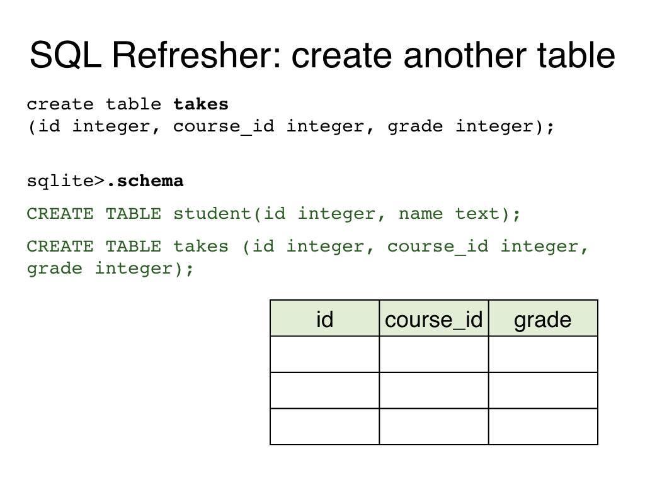

Slide 49
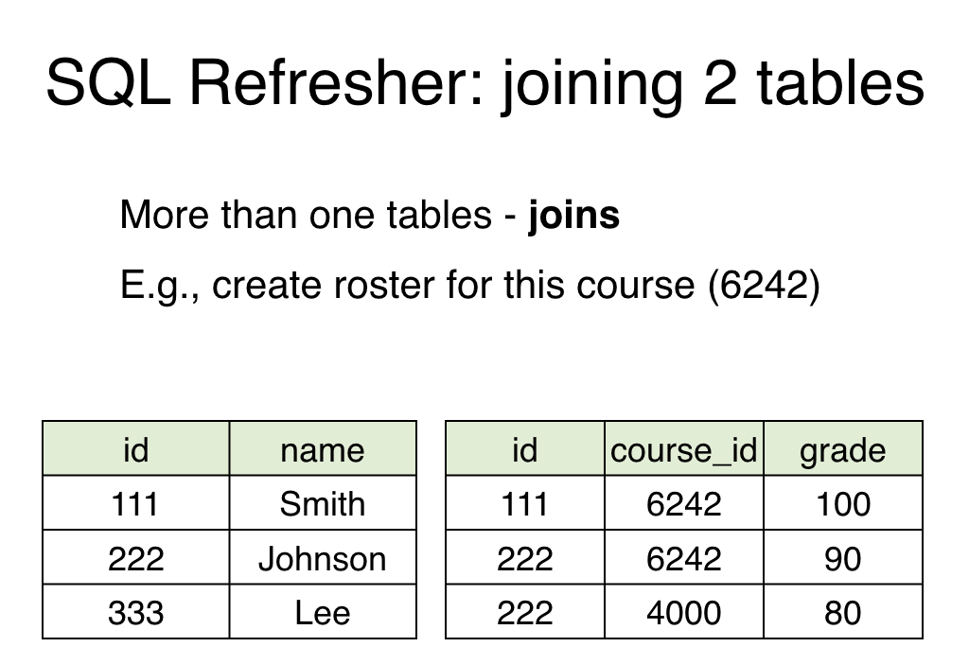

Slide 50
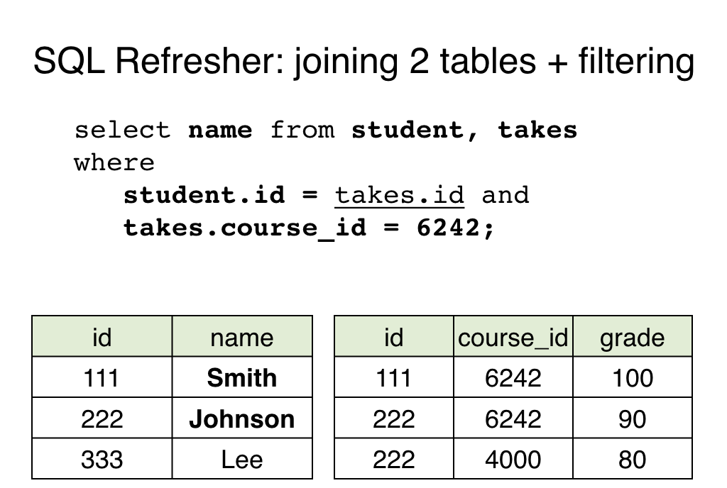

Slide 51
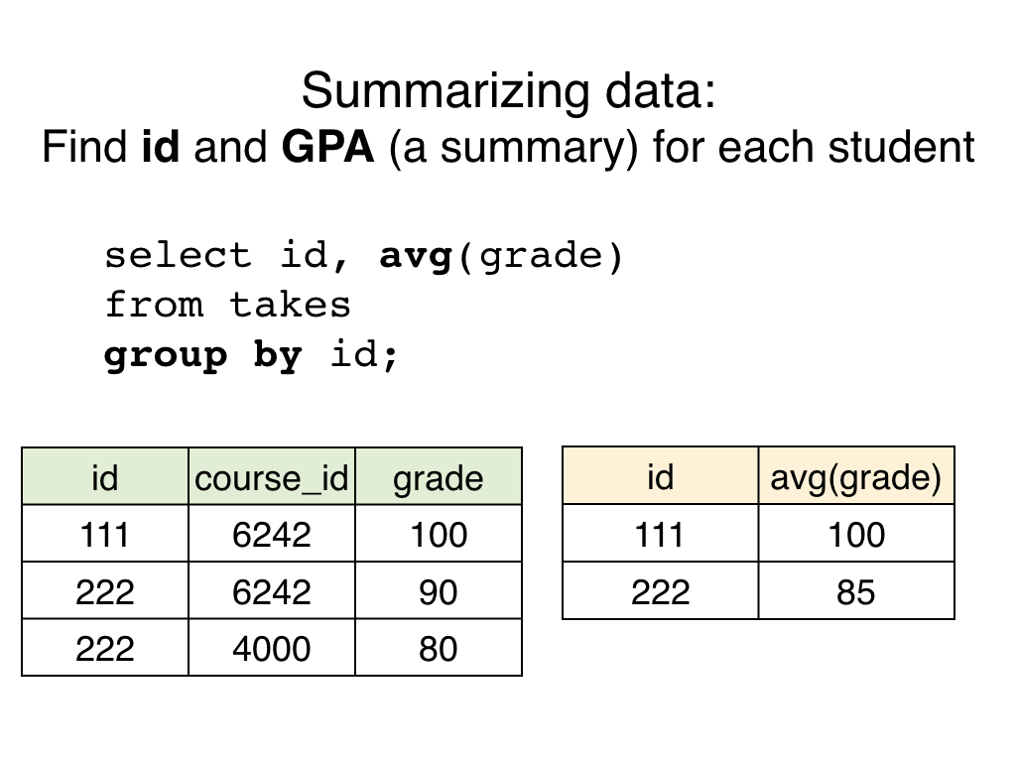

Slide 52
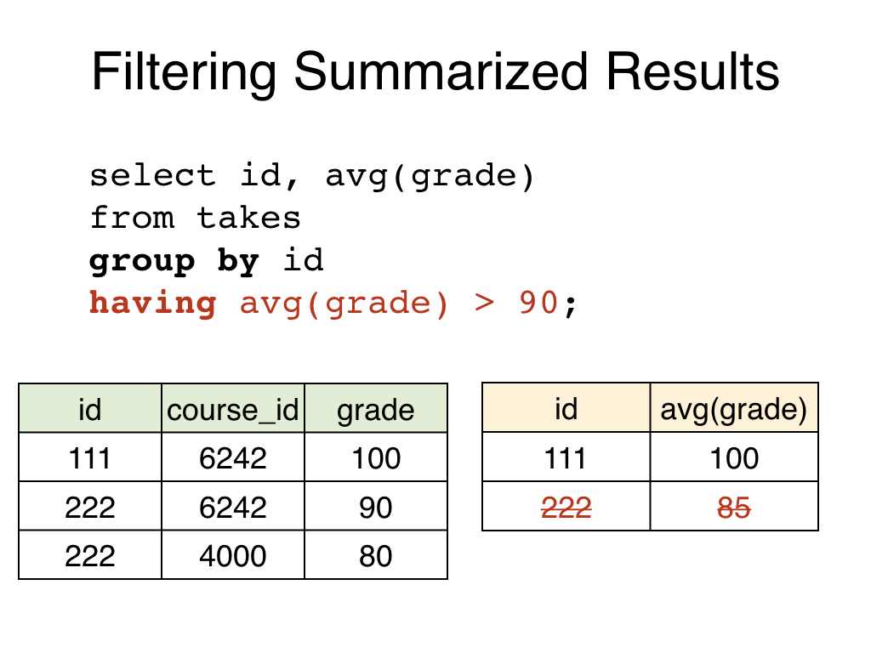

Slide 53
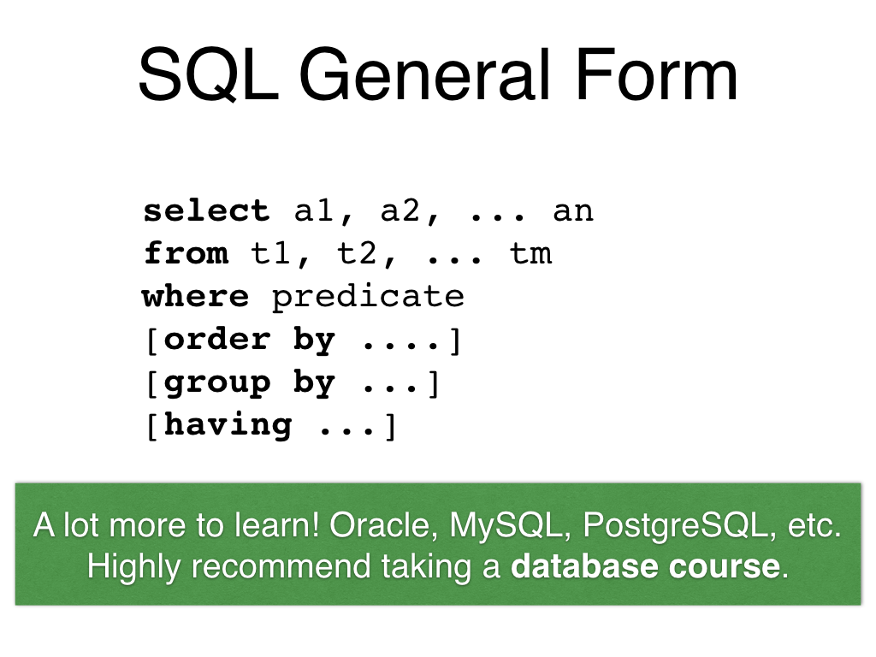

Slide 54
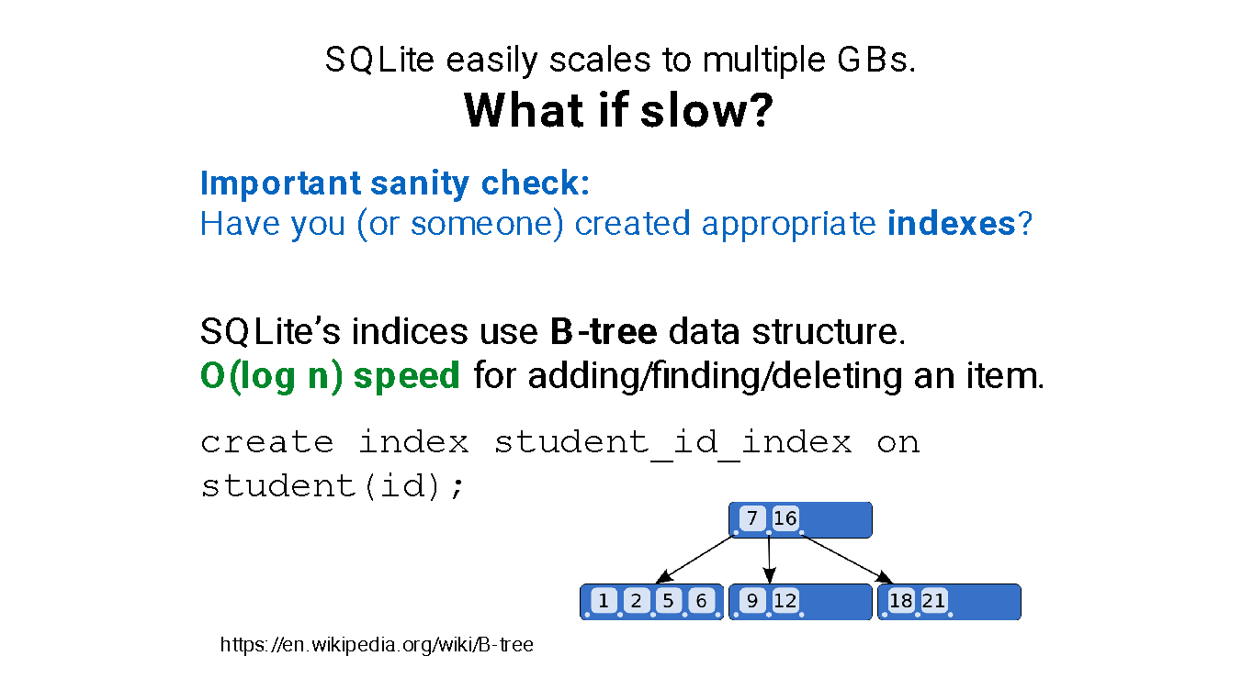

Slide 55


Data Cleaning
Data cleaning is the preprocessing of missing values and removal data noise.
Pre-processing missing values
Removing noise
Notes:
Data cleaning is a key step to preprocess the data.
Missing values is a common feature of data collected in almost all research and can have a significant effect on the conclusions that can be drawn from the data. It refers to the data value that is not stored for a variable in the observation of interest.
In addition, data noise cannot be avoided in most of cases of data analytics. This refers to a large amount of additional meaningless information. Random noise is often a large component of the noise in data.

Slide 56
Why the Need to Handle Missing Values?
Missing values are generated by collection errors or missing observations.
Missing values are the most common problem in data analytics.
When missing values come out, certain model performance is decreased.
Even for models that can handle missing values, they might be sensitive to it.
Notes:
Obviously, it is imperative to deal with missing values for the following reasons.
Missing values are generated by collection errors or missing observations, which is difficult to avoid.
Missing values are the most common problem in data analytics.
When missing values come out, certain model performance is decreased since missing values will lead to model bias.
Even for models that can handle missing values, they might be sensitive to it. Moreover, the model performance will be reduced with the increment of missing values such as data analytics on streaming data.

Slide 57
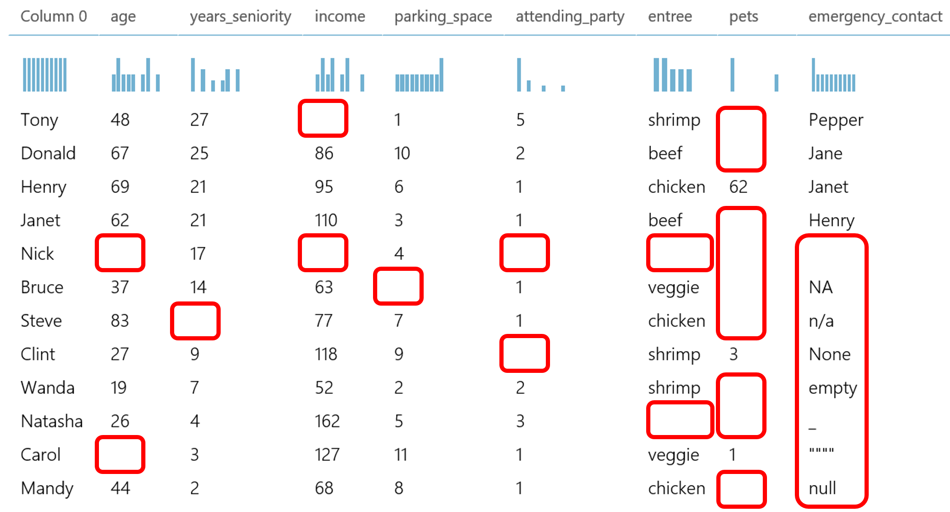
How to deal with missing values?
Typical methods to process missing values:
Deletion
Dummy substitution
Mean substitution
Frequent substitution
Regression substitution
Source: https://gallery.azure.ai/Experiment/Methods-for-handling-missing-values-1
Notes:
Typically, we can process missing values with methods including Deletion, Dummy substitution, Mean substitution, Frequent substitution, and Regression substitution.
We will introduce these methods.
Before that, you can observe various cases of missing values from these figures.

Slide 58
How to deal with missing values?
Typical methods to process missing values:
Deletion: removing records with missing values
Source: https://gallery.azure.ai/Experiment/Methods-for-handling-missing-values-1
Notes:
As shown in this figure, we can delete the rows with most of missing elements.
Generally, we can set a threshold for the ratio between # of missing elements/ # of elements for a certain row to implement deletion.

Slide 59
How to deal with missing values?
Typical methods to process missing values:
Dummy substitution: Replace missing values with a dummy value e.g. UNKNOWN for category values or 0 for numerical values
0
0
0
0
0
UNKNOW
0
Source: https://gallery.azure.ai/Experiment/Methods-for-handling-missing-values-1
Notes:
For the categorical attributes/features, we could use “UNKNOWN” to replace missing values.
In other words, we introduce additional attribute values, which will not significantly affect model performance if missing values don’t dominate these attributes.

Slide 60
How to deal with missing values?
Typical methods to process missing values:
Frequent substitution: If the missing values are categorical, replace the missing values with the most frequent item.
0
0
0
0
0
chicken
0
48
Source: https://gallery.azure.ai/Experiment/Methods-for-handling-missing-values-1
Notes:
In addition, we could use the most frequent attribute value to replace the missing values for the categorical attributes.
For example, missing values of the attribute “entree” can be filled out with most frequent item “chicken”.

Slide 61
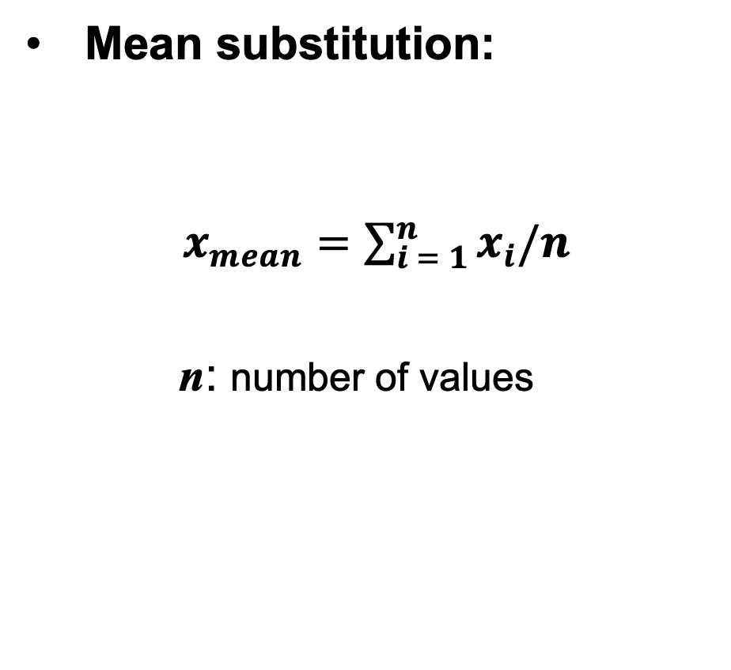
How to deal with missing values?
Typical methods to process missing values:
0
0
0
0
0
UNKNOW
0
48
Source: https://gallery.azure.ai/Experiment/Methods-for-handling-missing-values-1
Notes:
For continuous attributes, we could use mean of attribute values to replace the missing values.
Take the attribute “Age” as an example, we use the mean value 48 to replace the missing values for this attribute.

Slide 62
How to deal with missing values?
Typical methods to process missing values:
Regression substitution: Use a regression method to replace the missing values with regressed values.
Time-series data
ARIMA [1] (autoregressive integrated moving average)
0
0
0
0
0
UNKNOW
0
48
[1] Contreras, J., Espinola, R., Nogales, F. J., & Conejo, A. J. (2003). ARIMA models to predict next-day electricity prices. IEEE transactions on power systems, 18(3), 1014-1020.c
Source: https://gallery.azure.ai/Experiment/Methods-for-handling-missing-values-1
Notes:
Moreover, we can employ regression methods such as ARIMA to estimate the missing values if we have attributes with time-series features.

Slide 63
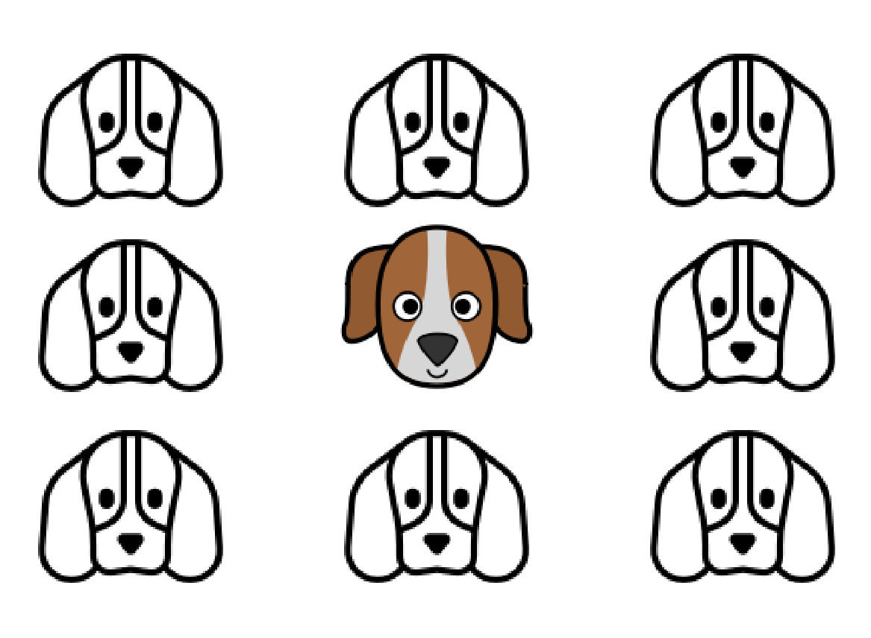
Outliers
An outlier is a data point that differs significantly from other observations.
Outliers can be very common in multidimensional data.
Outliers can be results of bad data collection.
Outliers would distort the models.
Some models are sensitive to outliers.
Sometimes outliers are the interesting data points.
Notes:
In addition to missing values, outliers are another challenge to data processing.
Outliers can be very common in multidimensional data such as high-dimensional data.
Outliers would distort the models, which will decrease model performance significantly. For example, outliers will reduce the clustering performance with KMEANS clustering methods.
Some models such as KMEANS clustering methods are sensitive to outliers.
Sometimes outliers are the interesting data points. For example, streaming data will introduce challenge on judging outliers since some “outliers” will be a clue for detecting concept drift.

Slide 64

How to deal with outliers?
It depends on how to generate the outliers.
Keep outliers
We should pay more attention to the outliers since they may be genuine observations in the collected data.
In many applications, outliers provide crucial information for data analytics.
Notes:
For example, credit card fraud detection alerts purchases that fall outside a customer’s usual purchase patterns.

Slide 65
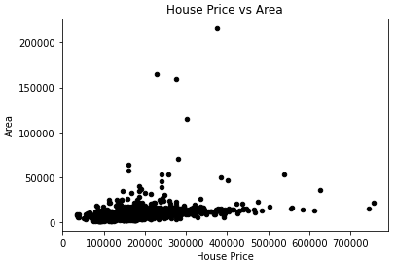
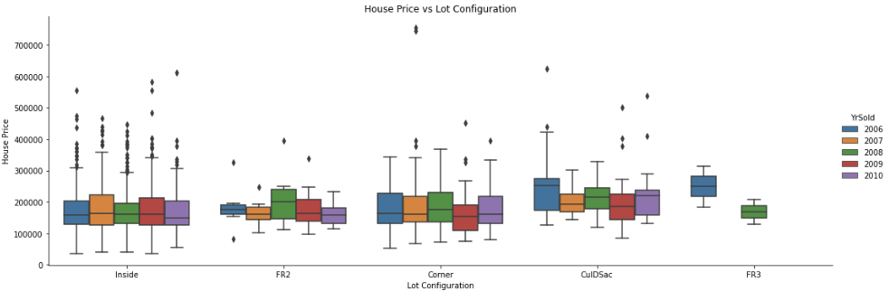
How to detect outliers?
Two popular methods:
Scatter Plot
Box Plot
Notes:
Some tools will help detect outliers such as scatter plot and box plot.

Slide 66
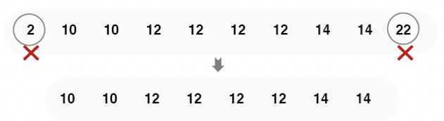

How to deal with outliers?
It depends on how to generate the outliers.
Exclude outliers
Trimming: discarding the outliers.
Replacement: replacing the outliers with the nearest “normal” data point
Notes:
Additionally, we can process outliers with methods such as trimming and replacement if the outliers can be recognized accurately.

Slide 67

Data Normalization
Data normalization is the rescaling of numerical values to a specific range.
Two popular methods:
Notes:
Data normalization is a process in which data attributes within a data model are organized to increase the cohesion of entity types.
In other words, the goal of data normalization is to reduce and even eliminate data redundancy.
There are two primary advantages of having a highly normalized data schema:
Increased consistency. Information is stored in one place and one place only, reducing the possibility of inconsistent data.
Easier object-to-data mapping. Highly-normalized data schemas in general are closer conceptually to object-oriented schemas because the object-oriented goals of promoting high cohesion and loose coupling between classes results in similar solutions (at least from a data point of view).

Slide 68
Data Down-Sampling
Data down-sampling is reducing large data to a smaller and more manageable size.
Record down-sampling (clustering): select the records and only choose the representative subset from the data.
Attribute down-sampling (Feature selection): select only a subset of the most important attributes from the data.
Notes:
Downsampling is the process of reducing the sampling rate of a signal, which is an effective way to handle imbalanced data.

Slide 69


Slide 70


Slide 71
Data → Features

Slide 72

Latent Semantic Analysis (LSA)
Similarity between human and user is 0, if we use the co-occur of words in the document.
Solution:
LSA: a fully automatic mathematical/statistical technique for extracting and inferring relations between expected contextual usage of words in passages of discourse.
C is the original word x document matrix with m words and n docs.
U describes the original row entities as vectors of derived orthogonal factor values
V describes the original column entities in the same way
Σ is a diagonal matrix containing scaling values
Notes:
https://www.youtube.com/watch?v=bzNch-dBCN8

Slide 73

Features
Feature is a distinctive attribute or aspect of something.
In machine learning based data analytics, a feature is an individual measurable property or characteristic of a phenomenon being observed.
E.g. Face Recognition:
Nose
Mouth
Eye
Ear
… …
Notes:
Data will contain many attributes/features.
For face recognition, various features such as shape of nose and distance between eye are useful for building models.

Slide 74

Feature Extraction
Feature extraction is to extract features from raw data or even create new features on the raw data.
Creating new features is a process to generate new variables/features based on existing variables/features.
Notes:
Feature extraction is to extract features from raw data or even create new features on the raw data.
Specially, creating new features is a process to generate new variables/features based on existing variables/features.
For example, “New Day” and “New Month” are new features created based on feature “Date”

Slide 75

Feature Extraction
Different sets of features will lead to different performance of data analytics.
Face Detection
Performance comparison of detectors using multiple feature sets on the CMU+MIT frontal face data set.
Source: Xiao, R., Zhu, H., Sun, H., & Tang, X. (2007, October). Dynamic cascades for face detection. In 2007 IEEE 11th International Conference on Computer Vision (pp. 1-8).
Notes:
However, different sets of features will lead to different performance of data analytics.
As shown in this figure, more features will enhance model performance.

Slide 76

Feature Engineering
Feature engineering is a process that is to represent the features by feature selection or feature reduction for data analytics.
Requiring collaborations between domain experts and data scientists
A trade-off between including more informative features and avoiding too many unrelated features
Informative features improve model performance.
Unrelated features reduce model performance.
Notes:
However, not all features will be useful regarding feature redundancy and irrelated features.
Feature engineering is a process that is to represent the features by feature selection or feature reduction for data analytics.
Therefore, before the data is input to the model, the data needs to be represented with the flow shown in this figure.
Actually, we need to achieve a trade-off.

Slide 77

Feature Selection
Feature selection is able to remove features that are either redundant or irrelevant without loss of information of data.
Simplifying the models
Shortening time for model construction
Avoiding curse of dimensionality
Enhancing model generalization

Slide 78

Curse of Dimensionality
It refers to phenomena that arise when analyzing and organizing data in high-dimensional spaces.
Certain models might perform poorly in high-dimensional space.
More features might need more samples to fill out the high-dimensional space.
Samples are difficult to be obtained.
Notes:
Feature selection can help overcome Curse of Dimensionality for data analytics in high-dimensional space.

Slide 79

Approached for Feature Selection
There are three categories of feature selection methods.
Filter methods select features regardless of the model.
Wrapper methods select features based on performance of a specific model with a greedy search in a forward/backward manner.
Model-based methods select features during the procedure of model construction.

Slide 80
Filter Methods
Generally, filter methods are to calculate the correlations between the features and target attributes.
Statistical measurements
Chi squared test
Mutual information
Pearson correlation
… …
Notes:
We will focus on Chi squared test and Mutual information in this section.

Slide 81

Chi Squared Test

Slide 82

Chi Squared Test

Slide 83

Chi Squared Test
Predicting Play Tennis
Two features
Outlook
Wind
Target Attribute
Play Tennis
Notes:
For each feature, a contingency table is created with m rows and k columns. Each cell (i,j) denotes the number of rows having attribute feature as i and class label as k. Thus each cell in this table denotes the observed frequency. To calculate the expected frequency for each cell, first the proportion of the feature value in the total dataset is calculated and then it is multiplied by the total number of the current class label.
Here the output variable is the column named “PlayTennis” which determines whether tennis was played on the given day given the weather conditions.

Slide 84



Chi Squared Test
The contingency table for the feature “Outlook” is constructed as below.

Slide 85


Chi Squared Test
The contingency table for the feature “Wind” is constructed as below.
On comparing the two scores, we can conclude that the feature “Wind” is more important to determine the output than the feature “Outlook”.

Slide 86

Mutual Information
In information theory, the mutual information (MI) of two random variables is a measure of the mutual dependence between the two variables.
Notes:
Mutual information is intimately linked to that of entropy of a random variable.
Mutual information has been successfully adopted in filter feature-selection methods to assess both the relevancy of a subset of features in predicting the target variable and the redundancy with respect to other variables.
Y could be target values while X will be features.
The straightforward idea to implement feature selection is to calculate MI values between all features and target values and select features with a predefined threshold.

Slide 87
Feature Reduction
Feature Reduction is the transformation of data from a high-dimensional space into a low-dimensional space so that the low-dimensional representation retains meaningful properties of the original data.
It is to reduce large numbers of observations and/or large numbers of variables for tasks such as signal processing, speech recognition, natural language processing, and bioinformatics.
The difference between feature selection and feature reduction is that feature selection is directly to eliminate original features while feature reduction is to map the original high-dimensional feature space to a low-dimensional space.
The data transformation may be linear or nonlinear.
Notes:
These principal components would be orthogonal. In other words, they would be independent.
The difference between feature selection and feature reduction is that feature selection is directly to eliminate original features while feature reduction is to map the original high-dimensional feature space to a low-dimensional space, where the dimensions of the low-dimensional space is predefined.

Slide 88
Feature Reduction
A linear or non-linear transform on the original feature space
Unsupervised methods
Principal Component Analysis (PCA)
Independent Component Analysis (ICA)
Autoencoder
Supervised methods
Linear Discriminant Analysis (LDA)
Notes:
Generally, methods of feature selection can be classified into two categories: linear and non-linear.
The data transformation may be linear, as in principal component analysis (PCA), but many nonlinear dimensionality reduction techniques such as autoencoder also exist.
On the other side, it can be classified into supervised and unsupervised regarding ground truth.

Slide 89

Model-based Methods for Feature Selection
Model-based methods learn the best features that contribute to the model performance when constructing these models.
The most common methods are regularization methods.
It is to penalize the model, which introduce additional constraints into the optimization of learning the models with lower complexity.
Notes:
This figure indicates the flow of model-based feature selection.
All features are the initial input to the feature selection procedure.
Basically, the feature subset is iteratively built with respect to the model performance when constructing models.

Slide 90
LASSO (Least Absolute Shrinkage and Selection Operator)
It is a powerful method that perform two main tasks: regularization and feature selection.
First formulated by Robert Tibshirani in 1996.
The LASSO method puts a constraint on the sum of the absolute values of the model parameters, the sum has to be less than a predefined value (upper bound).
In order to do so the method apply a shrinking (regularization) process where it penalizes the coefficients of the regression variables shrinking some of them to zero.
During features selection process the variables that still have a non-zero coefficient after the shrinking process are selected to be part of the model. The goal of this process is to minimize the prediction error.
Notes:
The first method introduced is LASSO.
The basic idea is shown here.
From another perspective, the goal of this process is to improve the model accuracy, where the coefficient for features can be treated as feature weights.

Slide 91
LASSO (Least Absolute Shrinkage and Selection Operator)
There are many advantages in using LASSO method.
It can provide a promising prediction accuracy, because shrinking and removing the coefficients can reduce variance without a substantial increase of the bias.
This is especially useful when the data has a small number of samples and a large number of features.
LASSO helps increase the model interpretability by eliminating irrelevant variables that are not related to the target variable, which would reduce overfitting as well.
Notes:
This is especially useful when the data has a small number of samples and a large number of features. In other words, it would be effective to analyze high-dimensional, low-sample size data.
For example, cell classification with micro-array data in biomedical domain will involve around hundreds of samples with 20 ~ 50 thousands of genes. LASSO would be an effective method to select less than 50 genes for this classification problem.
Overfitting refers to a model that models the training data too well. It happens when a model learns the detail and noise in the training data, it negatively impacts the performance of the model on testing data. This means that the noise or random fluctuations in the training data is picked up and learned as concepts by the model. The concepts however do not apply to new data and negatively impact the models ability to generalize.

Slide 92


LASSO in the Linear Model
Notes:
Let me show you an example with linear regression model.

Slide 93


LASSO Based Object Function for Linear Models
The objective of optimizing the model is to minimize the mean square errors.
This optimization problem is equivalent to the parameter estimation that follows.
Notes:
We can obtain the weight W with maximum likelihood estimation (MLE)

Slide 94

Feature Selection via Tree Model
Tree-based methods will estimate the feature importance during the procedure of constructing models to select important features.
The most common method could be decision tree and random forest.
Notes:
Another model-based method is Tree-based model.
Generally, we can rank the feature importance when contracting the tree for different tasks such as classification.
The most common method could be decision tree and random forest.

Slide 95

Decision Tree
Decision tree builds classification or regression models in the form of a tree structure.
A decision tree predicts the value of a target variable by following the decisions in the tree from the root (beginning) down to a leaf node.
A tree consists of branching conditions where the value of a predictor is compared to a trained weight.
The number of branches and the values of weights are determined in the training process.
Source: https://medium.com/analytics-vidhya/machine-learning-decision-tree-regression-ff8563ffaf52
Notes:
Let me give you a basic example with decision tree.
This figure is to show a decision tree to complete a task that is to decide if the job offer should be accepted.
The leaf node presents the decisions on if the job offer should be accepted.
The other nodes show the attributes (features) related to this task.
Each node will be assigned a weight during training with methods such as information gain, where the weight can be treated as the importance of the feature.
The challenge to build a decision tree is to choose appropriate depth and width for this tree that will affect the performance significantly.
We will introduce the details in the module 14 that is Introduction to Machine Learning: Classification.

Slide 96
Question, Quizzes, Assignments, Final Project

